Slide 1
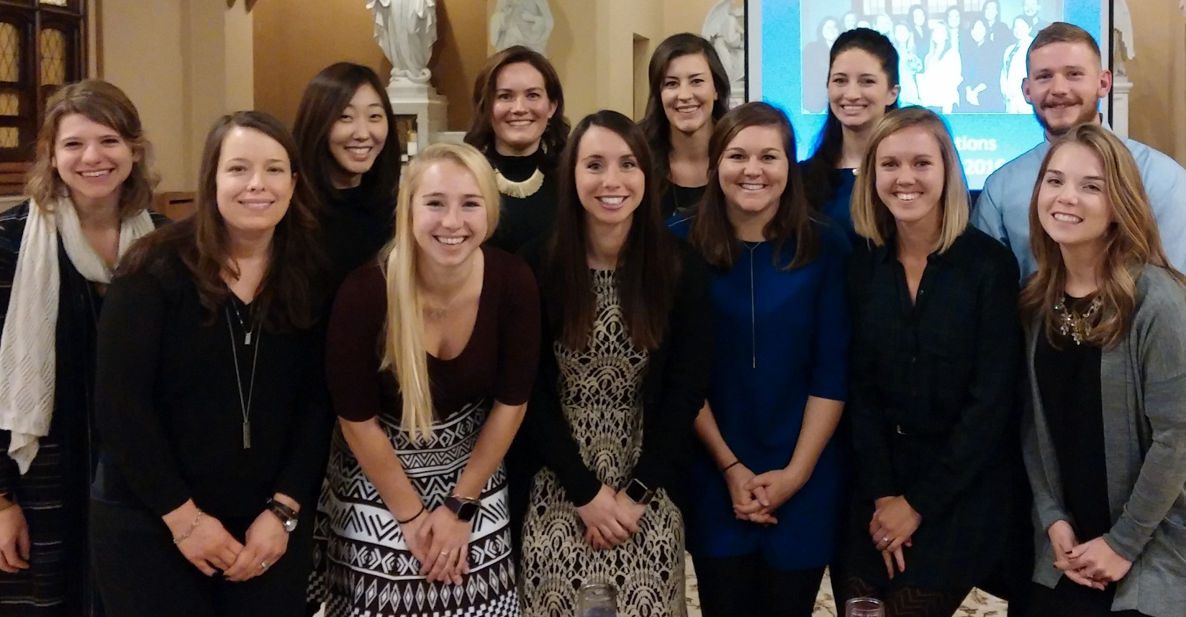
Fontbonne University Individualized Supervised Practice Pathway (ISPP)
Dena B. French, MFN, RD, LD
ISPP Program Director
The Graduating ISPP Class of 2016

Slide 2
Objectives
What is an ISPP?
Fontbonne’s ISPP
Campus “Tour”
Program overview & curriculum
Supervised practice activities
Applying to the program
Requirements
Timeline
FAQ’s

Slide 3
What is an ISPP?
ACEND Accredited Program
Created in 2011 to address the number of unmatched, qualified students
ISPPs increase the number of internship positions
Current DI match rate is 50 – 55% nationwide
In April 2016, there were 2407 unmatched students

Slide 4
What is an ISPP?
Meets the same standards as other supervised practice programs (DI’s)
ISPP interns…
Complete a minimum of 1200 supervised practice hours
Meet each of the core competencies for the RD (CRD’s)
Are eligible to sit for the RD/N exam upon successful completion
What’s the difference??
Must receive a “No Match” to apply

Slide 5
The ISPP at Fontbonne University
Accepts 12 qualified, unmatched students per year
Interns have come from all over the US including Texas, California, New York, and Washington
Takes ~19 months to complete
Includes a Master of Arts in Family & Consumer Sciences
Program focus: health communication studies
We are not a distance program
Relocation to the St. Louis, MO area is required
All preceptors and sites are arranged for you

Slide 6
Location

Slide 7
Fontbonne’s Mission
“Fontbonne University, a Catholic institution sponsored by the Sisters of St. Joseph of Carondelet, is committed to the common good through the daily pursuit of transformative education, inspiring students to become global citizens who think critically, act ethically and serve responsibly.”
(Fontbonne University, 2016)

Slide 8
Fontbonne Facts
Established in 1923 by the Sisters of St. Joseph of Carondelet
Originally an all-women’s college
Located in Clayton, St. Louis County, Missouri
Private, Non-profit, Catholic, Co-ed, Liberal Arts
Offers 42 undergraduate majors; 17 graduate programs
Enrollment (as of Fall ‘16): 1526
Undergraduate: 1105 (82% full time; 6% distance)
Graduate: 608 (45% full time; 32% distance)
Student diversity: 31%
Represents 28 countries
Faculty: 229; 76% of full-time faculty hold a Ph.D. or the highest degree in their field
Alumni: 19,315
(Fontbonne University, 2016; NCES, 2016)

Slide 9
Why the ISPP at Fontbonne?
Small campus and program = personal attention
Form relationships with other students, staff, and faculty
Similar experience to a traditional DI + Master’s program
Unique program focus stands out on resume

Slide 10
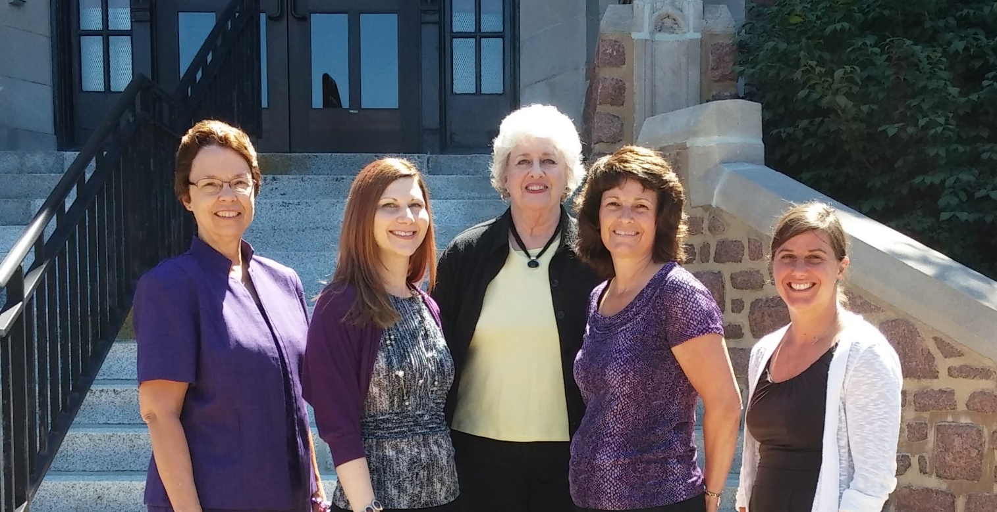
Meet the FCS Department Staff & Faculty
Left to right: Mary Beth Ohlms (department chairperson), Dena French (DPD/ISPP director), Vickie Logston (department assistant), Jaimette McCulley (graduate program director), & Jamie Daugherty (instructor)

Slide 11
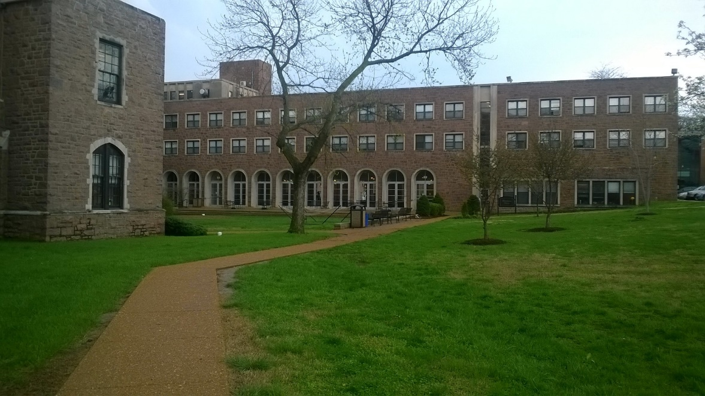
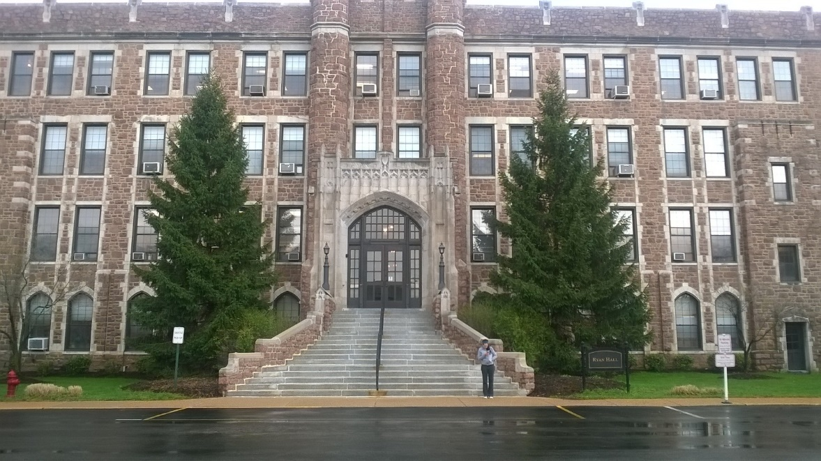
Fontbonne’s Campus
Notes:
Fontbonne is a small Catholic university. We have about 2000 students total, with a student to faculty ration of 11:1. This provides for relationship building and one to one attention between students and faculty.

Slide 12
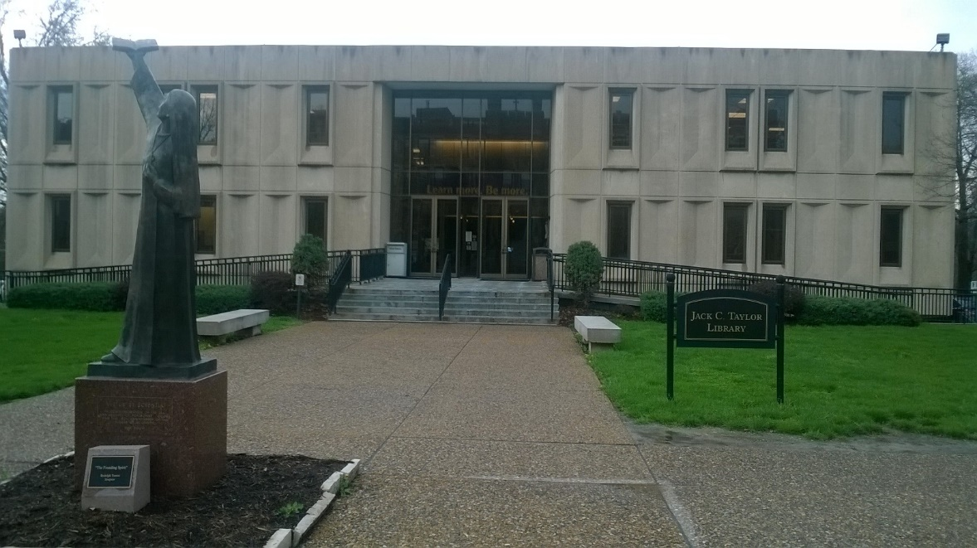
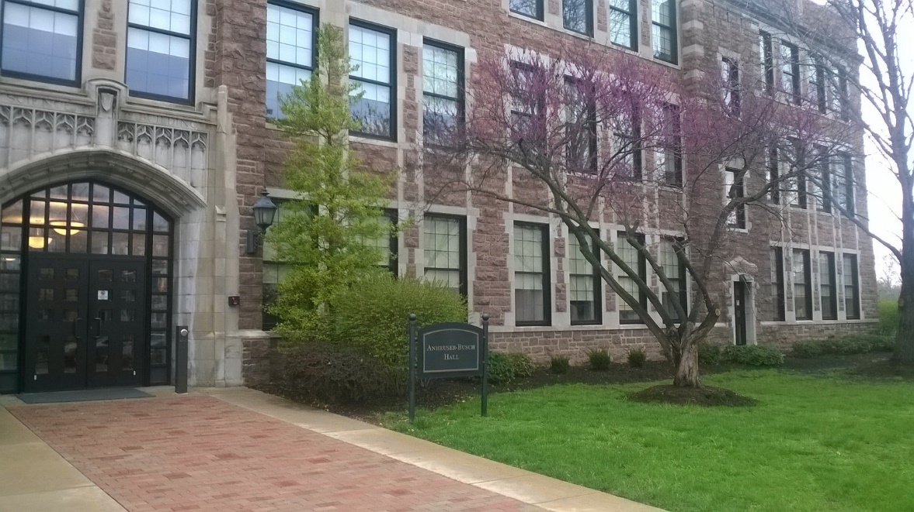
Fontbonne’s Campus
Notes:
Top picture: library
Bottom picture is Anheuser Busch hall, where the FCS department is housed.

Slide 13
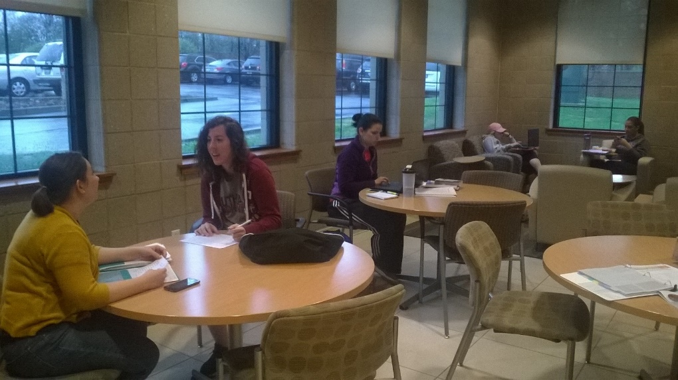
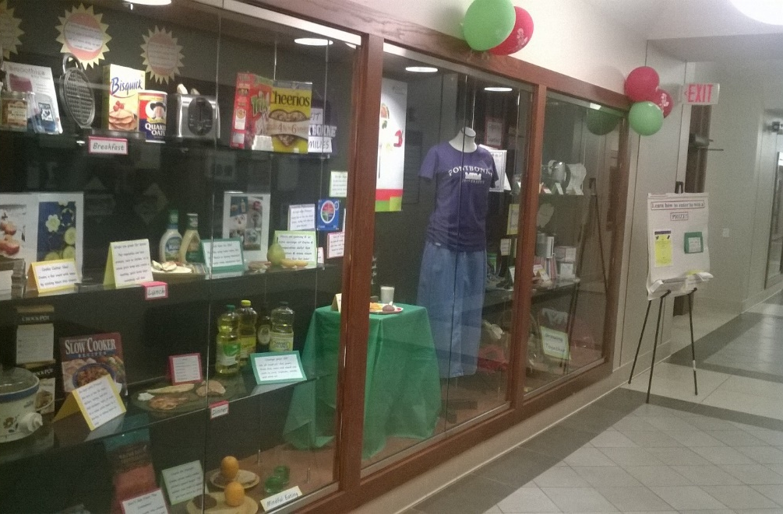
Fontbonne’s Campus
Notes:
Top: student lounge area
Bottom: National Nutrition Month display by junior dietetics students

Slide 14
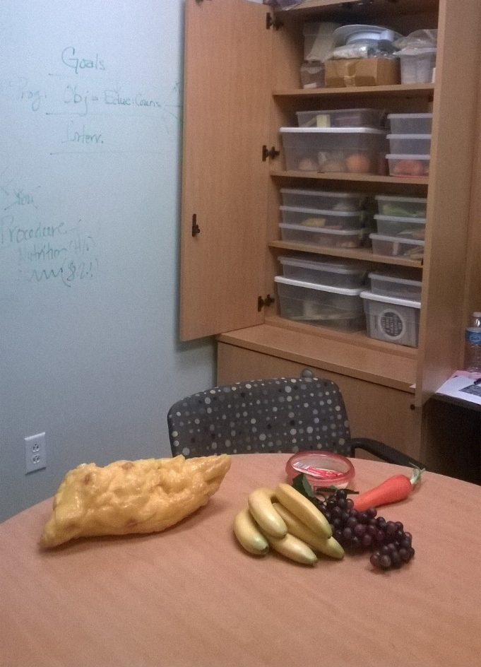
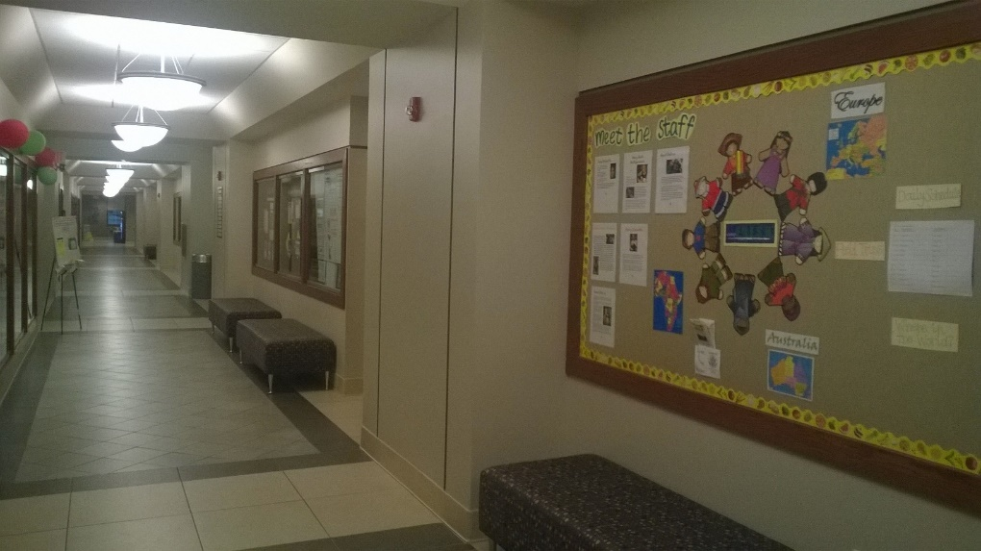
Fontbonne’s Campus
Notes:
Left: counseling/consultation room for practice counseling sessions

Slide 15
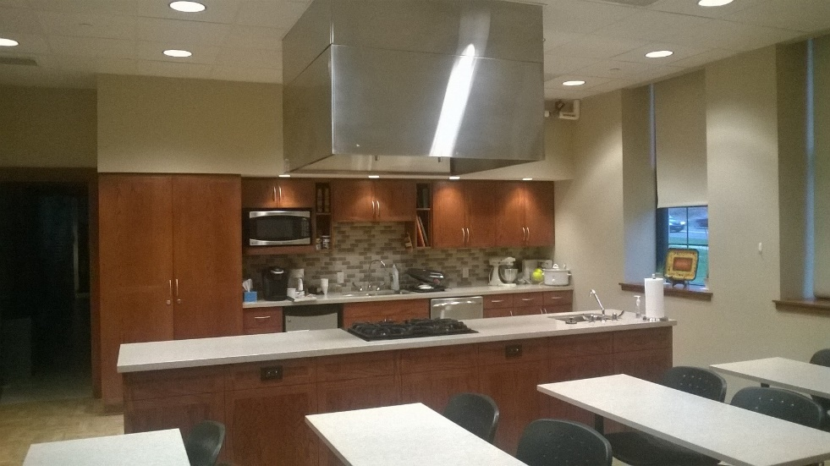
Fontbonne’s Campus
Notes:
Food science demo and laboratory

Slide 16
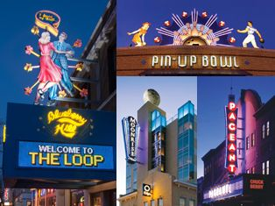
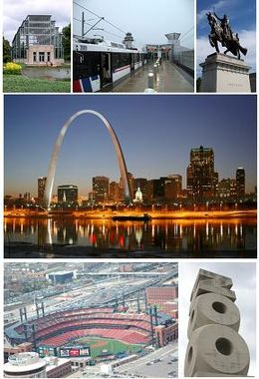
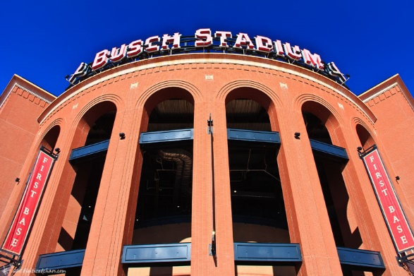
Living in St. Louis
Sports
Recreation
FREE attractions
Food!
Notes:
St. Louis has something to offer every interest!

Slide 17
Fontbonne University ISPP Program Overview
Summer | Fall | Spring
First Summer: Interns arrive on campus the first week of June Program Orientation Graduate courses “pre” supervised practice experiences* | First Fall: Graduate courses “pre” supervised practice experiences* | Spring: Graduate courses “pre” supervised practice experiences*
Second Summer: Supervised Practice begins 1 graduate course | Second Fall: Supervised Practice, continued Program completion & graduation in December
*At least 80 supervised practice hours are built into the first Summer, Fall and Spring semesters via program organized activities. Interns may exceed this by completing additional volunteer activities of their choice (max of 40 hours) in order to earn time off, which can be used toward sick and personal days during supervised practice.
Notes:
Overview of the program.

Slide 18
Year One: Graduate Coursework & Pre-Supervised Practice
Semesters 1 – 3 include core coursework
Pre-supervised practice experiences built into fall & spring semesters
Catering event
Counseling/Education experience
Community wellness intervention
Field trips/other learning experiences
MNT simulation seminar to review and boost skills
Many required assignments & projects accumulate supervised practice hours

Slide 19
MA in FCS Required Concentration Courses
Framing Critical Issues in FCS
Advocacy and Public Policy: Addressing a World in Need
Globalization and the Human Condition
Leadership Development for Professional Practice
Applied Health Behavior to Enhance Health Outcomes
Interpreting and Translating Science for Consumers
Contemporary Applications for Health Communication
Statistical Methods for Research
Elective: Ethical Implications for Health Communication OR Cultural Competence in Health Communication
Course descriptions can be found on our website
Notes:
The MA in FCS is a unique program that offers courses related to communicating health information to patients/clients and influencing health outcomes. Course descriptions can be found on our website.

Slide 20
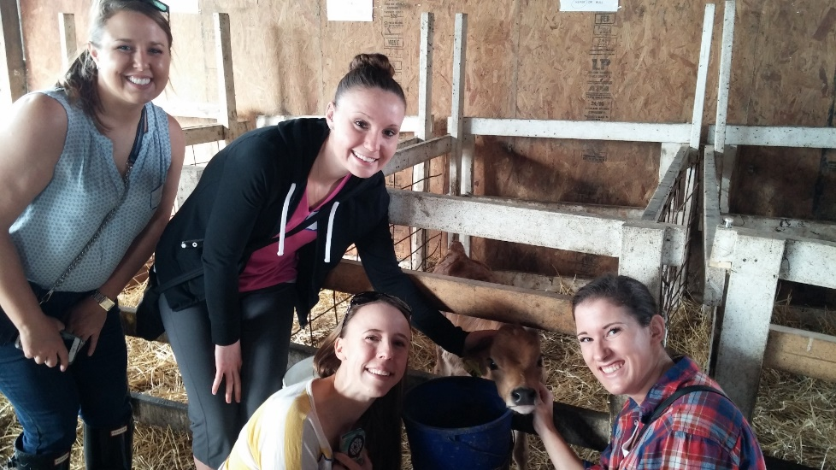
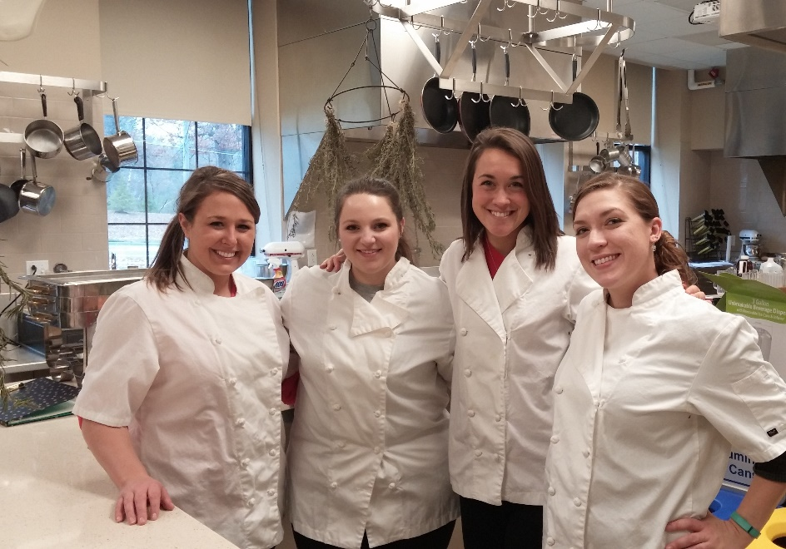
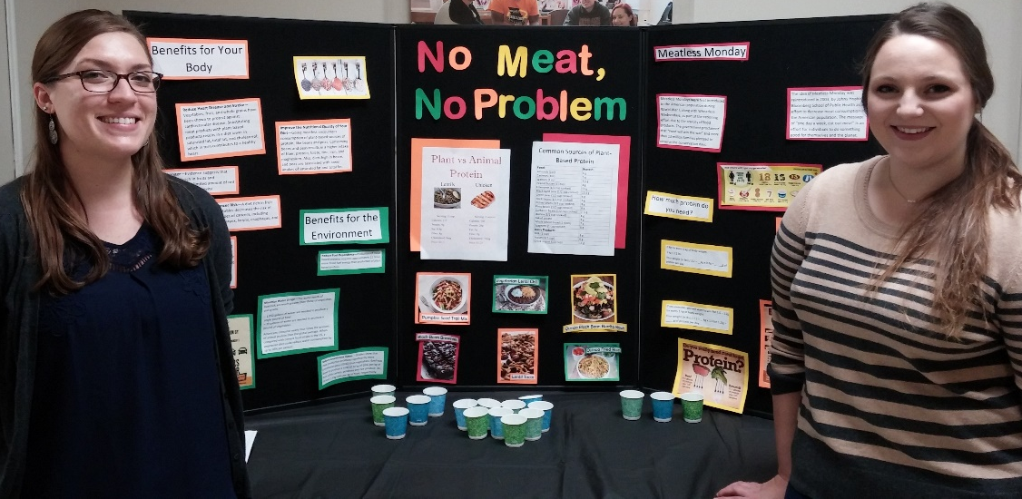
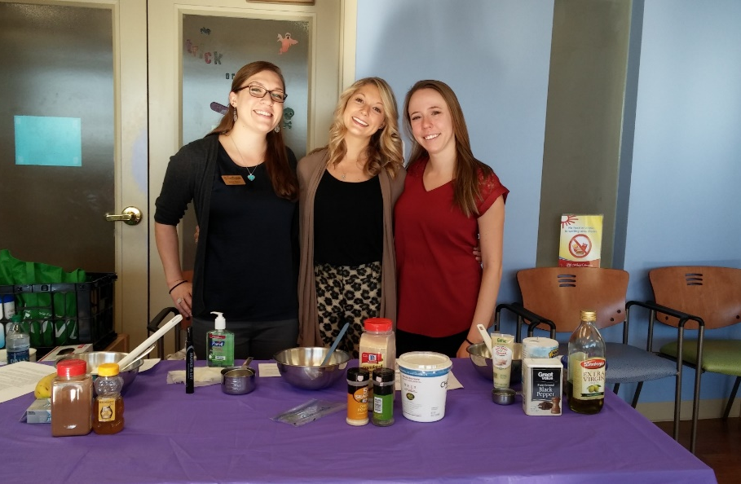
Year One: Pre-Supervised Practice
Notes:
Examples of activities during graduate school:
Dairy Farm Tour
Fontbonne community wellness intervention event
Catering event
Food demo and lesson for patients and families at a pediatric medical office

Slide 21
Year Two: Supervised Practice
Completed during final two semesters
Total of 30 weeks
10 – 12 weeks clinical
8 - 10 weeks food service management
8 - 10 weeks community
2 – 4 weeks electives/special interest rotations
Interns provide input on rotation selections to individualize the experience
Notes:
Supervised practice occurs between May and December of the second year.
Exact # of weeks will vary from student to student
Each intern follows a unique path through supervised practice sites

Slide 22
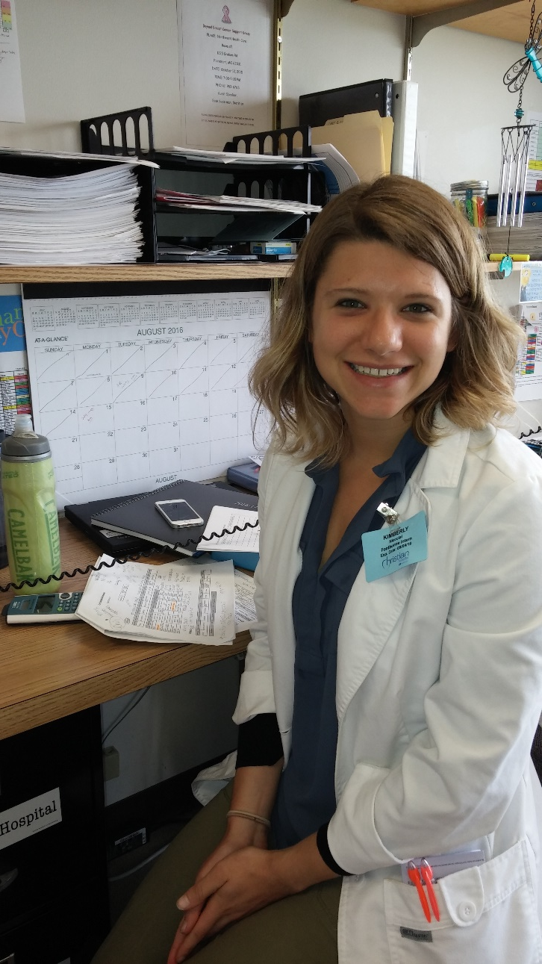
Clinical Rotation
Acute Care
small, mid size and large
facilities
Long term care / Rehab
Elective Sites
Cardiac Rehab
Dialysis
Outpatient Counseling
Outpatient Bariatric Surgery

Slide 23
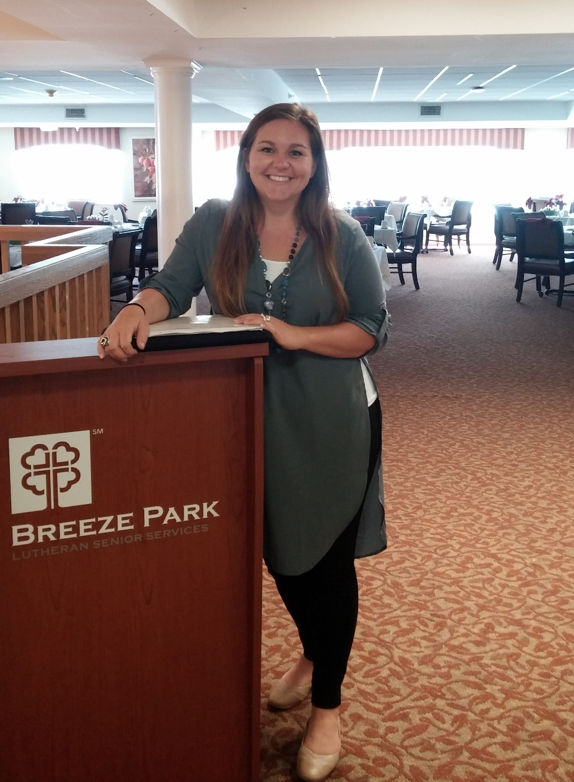
Food Service Management Rotation
Hospital Nutrition Services
Acute and Long Term Care
School Nutrition
K-12 & college/university
Elective sites
Grocery store/School of Cooking

Slide 24
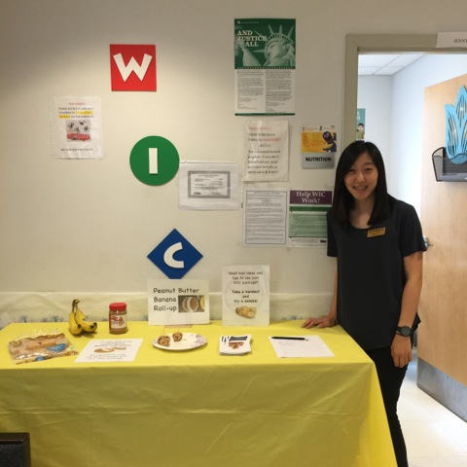
Community Nutrition Rotation
Local Outreach Programs
Agency on Aging
WIC
Cooking Matters
School Outreach & Youth Development
Public Health Department
Health Promotion & Disease Prevention Program
Private Practice
Outpatient
Worksite health & wellness
Community gardening/farming and education

Slide 25
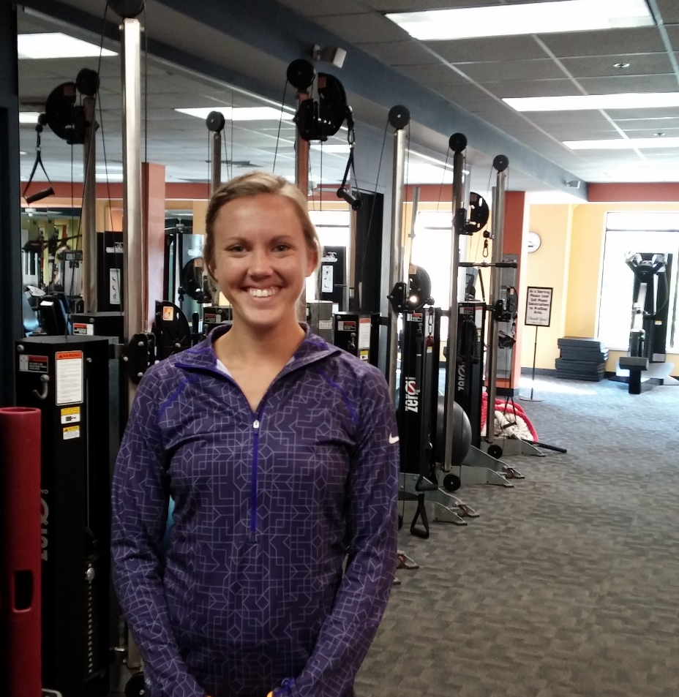
Electives/Special Interest
Extended rotations in any area
Sports/Fitness
Holistic Health
Private Practice/Business
Sites can be added based on student contacts!

Slide 26
Fontbonne University ISPP Estimated Program Costs
Tuition & Fees (based on 2017-18 rates) | $29,804
Additional Course Fees (covers cost of RDN Exam Study Guide and computerized competency tracking tool) | $500
Textbooks and Reference Materials* | $ 800
Professional Liability Insurance | $ 15/year
Health insurance & **Auto Insurance | Varies by plan
Background checks/drug screen | $200
ServSafe® certification (if not currently certified) | $80
***Housing/meals/transportation | $1000 (depends upon location and if accommodations are shared)
AND & local chapter membership | $74/year
Professional development/conference attendance (optional) | $400 – $1200
*Reliable computer and internet access are required
**A private vehicle is necessary, as supervised practice sites are located 5 to 45 miles from campus and public transportation is not feasible. Proof of auto liability insurance is required. Sites may assess parking fees.
***Apartment style housing is available for graduate students living on campus
Notes:
A reliable automobile is required. Public transit in the city is not adequate for traveling to sites.
Many interns share housing to save on costs. Connections to other selected interns will be made once all are accepted and confirmed.

Slide 27
Admission Criteria
General Qualifications
3.2 DPD GPA (includes professional & science)
Current intern group average is 3.53
3.0 overall GPA
MNT coursework within the last 5 years
GRE scores are not required
Other attributes:
Potential for success in graduate school
Strong personal statement and letters of recommendation
Profession-related experience (work or volunteer)
Engagement in leadership and service
Fit with our program and focus
Unique perspectives

Slide 28
When and How to Apply
If you have ever received a “no match,” you may apply via DICAS beginning Thursday, April 6th 2017 at 11am
You must also apply to our graduate program
Please see our website for specific application instructions
Applicants who meet minimum qualifications will be contacted to set up a phone interview
Initial round of phone interviews will take place between Friday, April 7th and Wednesday, April 12th
Preference will be given to applications received by Sunday, April 9th
We will continue to review applications on a rolling basis until our class is full
Selected applicants must confirm acceptance within 24 hours of notification
If accepted, you must make arrangements to relocate to St. Louis, MO for orientation and to start summer courses on June 5th

Slide 29
FAQ’s
Housing
On campus apartment style housing available
Off campus, residential “college” area
Tuition assistance
Graduate work study positions available
Working during the program
Full time not recommended, ~20 hours per week is the norm and manageable
Schedule must be flexible to accommodate required activities
When are courses held?
Most graduate courses begin 4:30 or later, although some ISPP required classes begin at 3pm

Slide 30
Good Luck on your Applications!
Thank you for considering our program!
Please visit our website, or contact me for more details
Website: www.Fontbonne.edu/ISPP
Email: DFrench@Fontbonne.edu

