Slide 1
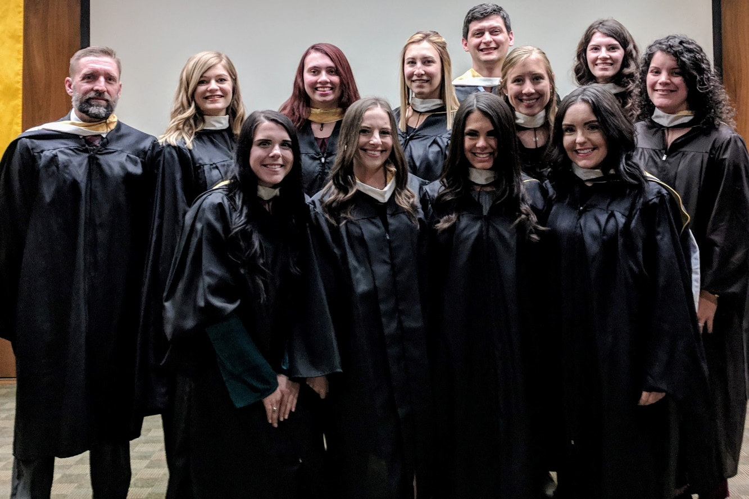
Fontbonne University Individualized Supervised Practice Pathway (ISPP)
Dena B. French, EdD, RDN, LD
ISPP Program Director & Experiential Coordinator
ISPP Class of 2018

Slide 2
Objectives
What is an ISPP?
Fontbonne’s ISPP
Campus “Tour”
Program overview & curriculum
Supervised practice activities
Applying to the program
Requirements
Timeline
FAQ’s

Slide 3
What is an ISPP?
ACEND Accredited Program
Created in 2011 to address the number of unmatched, qualified students
ISPPs increase the number of internship positions
Current DI match rate is 50 – 55% nationwide
In April 2017, there were 2026 unmatched applicants

Slide 4
What is an ISPP?
Meets the same standards as other supervised practice programs (DI’s)
ISPP interns…
Complete a minimum of 1200 supervised practice hours
Meet each of the core competencies for the RDN (CRDN’s)
Are eligible to sit for the RDN exam upon successful completion
What’s the difference??
Must receive a “No Match*” to apply
*“no match” does not need to be from most recent match cycle

Slide 5
The ISPP at Fontbonne University
Accepts up to 15 qualified, unmatched students per year
Interns come from all over the US including Texas, California, New York, and Washington
Takes ~19 months to complete
Includes a Master of Arts in Family & Consumer Sciences
Program focus: health communication studies
We are not a distance program
Relocation to the St. Louis, MO area is required
All preceptors and sites are arranged for you

Slide 6
Location

Slide 7
Fontbonne’s Mission
“Fontbonne University, a Catholic institution sponsored by the Sisters of St. Joseph of Carondelet, is committed to the common good through the daily pursuit of transformative education, inspiring students to become global citizens who think critically, act ethically and serve responsibly.”
(Fontbonne University, 2018)

Slide 8
Fontbonne Facts
Established in 1923 by the Sisters of St. Joseph of Carondelet
Located in St. Louis, Missouri
Private, Non-profit, Catholic, Co-ed, Liberal Arts University
Offers 44 undergraduate majors; 19 graduate programs
Enrollment (as of Fall ‘16): 1526
Undergraduate: 968 (85% full time)
Graduate: 558 (47% full time)
Student diversity: 22%
Represents 25 countries
10:1 student-to-faculty ratio
(Fontbonne University, 2018; NCES, 2018)

Slide 9
Why the ISPP at Fontbonne?
Small campus and program = personal attention
Form relationships with other students, staff, and faculty
Similar experience to a traditional, onsite DI + Master’s program
Unique program focus stands out on resume

Slide 10
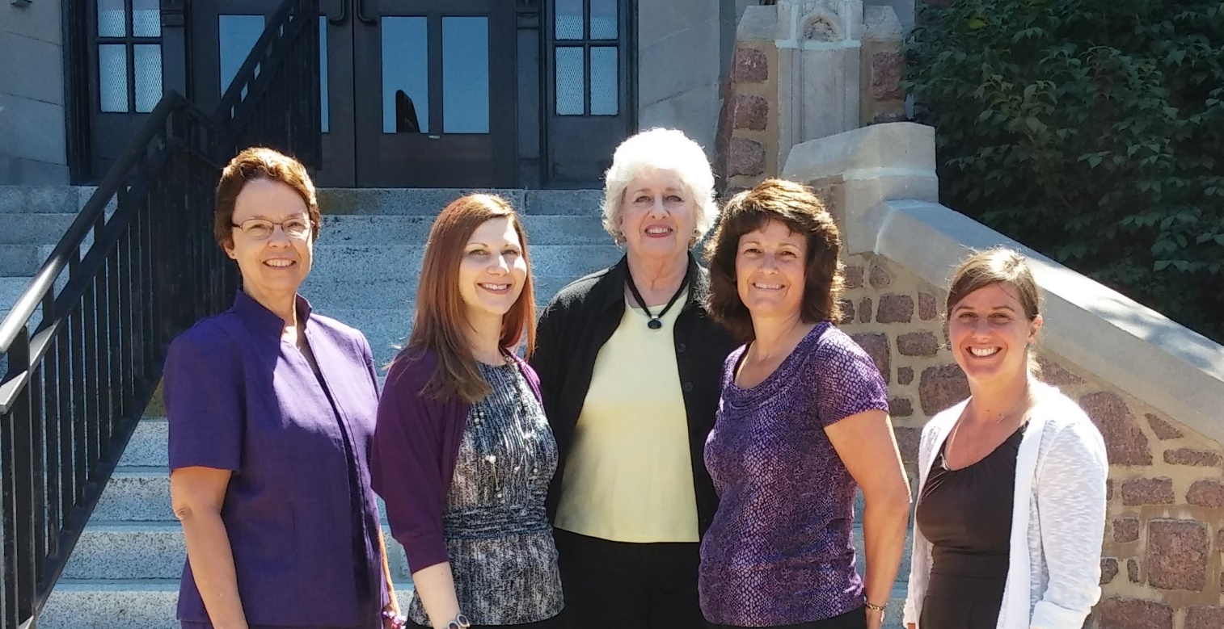
Meet the FCS Department Staff & Faculty
Left to right: Mary Beth Ohlms (Assistant Professor/Department Chairperson), Dena French (Instructor; DPD/ISPP director), Vickie Logston (department assistant), Jaimette McCulley (Assistant Professor / Graduate program director), & Jamie Daugherty (Assistant Professor)
Learn more about our department here

Slide 11
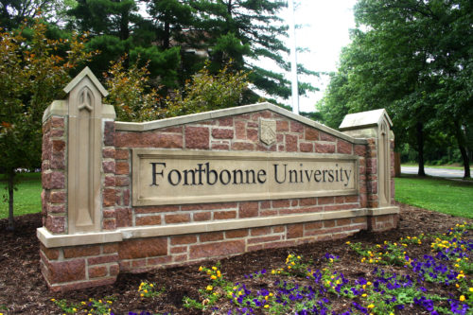
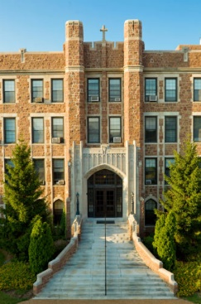
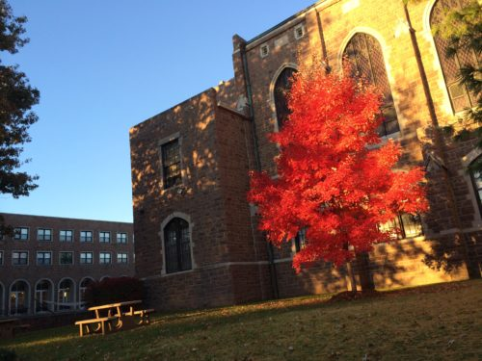
Our Campus
Notes:
Our campus is beautiful, especially in the springtime!

Slide 12
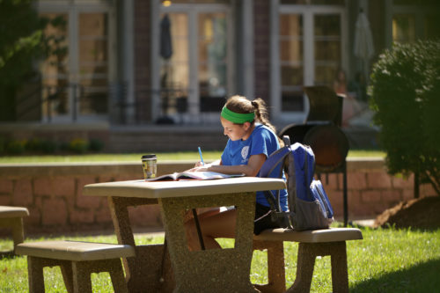
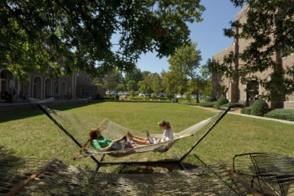
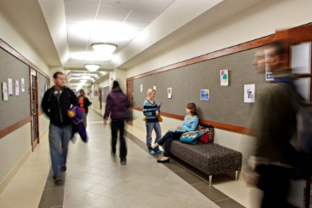
Our Campus
Notes:
Our campus has many great places for studying, relaxing, and socializing between classes!

Slide 13
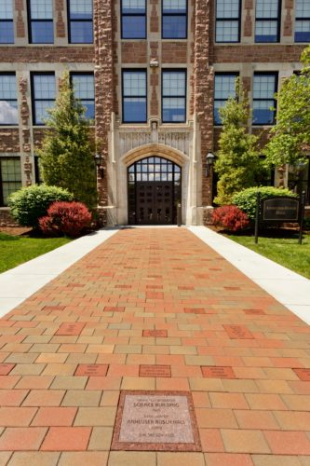
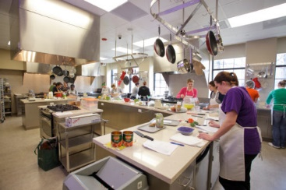
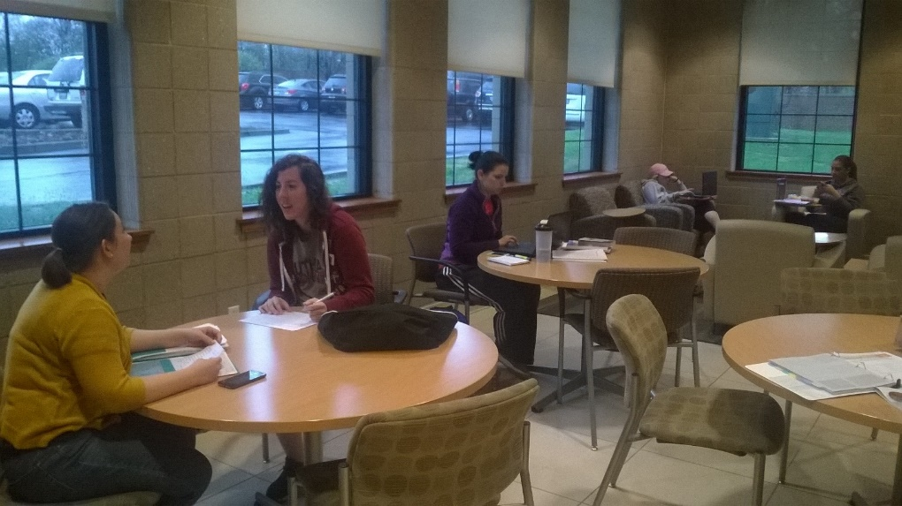
Our Campus
Notes:
Left: entrance to Anheuser Busch Hall, where our department is housed.
Right, top: Our department’s food science lab. ISPP students will utilize this for their catering event on campus!
Right, bottom: Student lounge located on our floor, used quite often by our students. There are two former ISPP students seated at the front table!

Slide 14
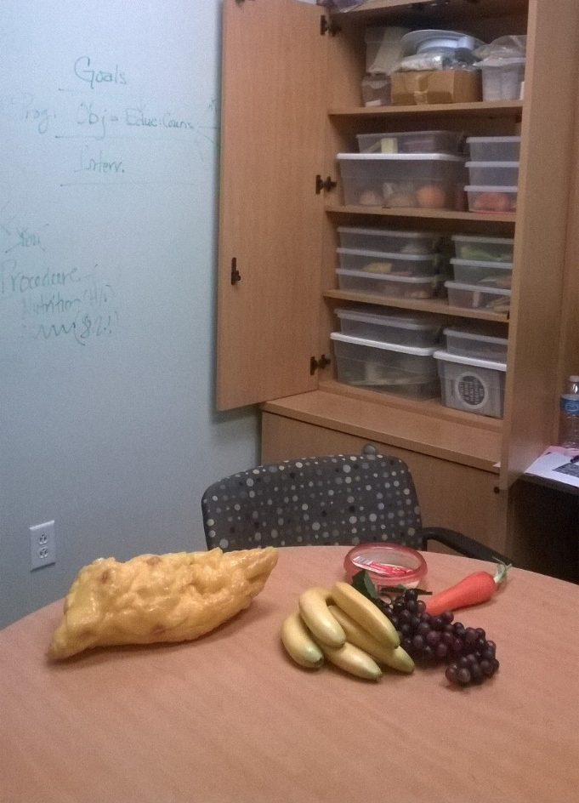
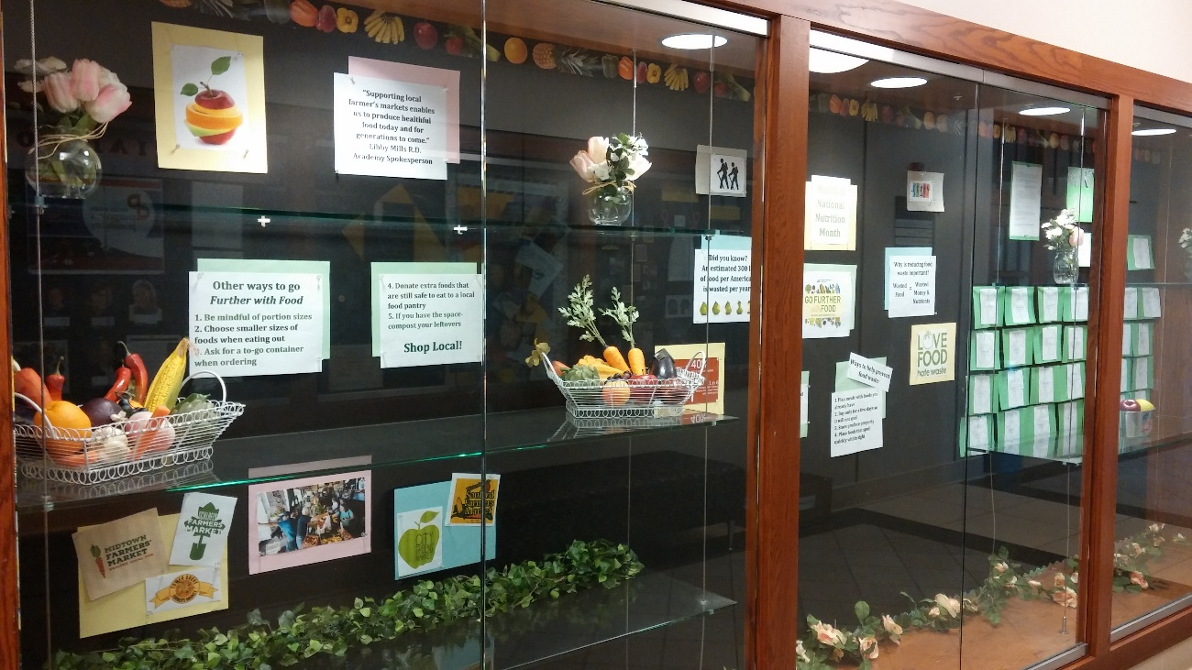
Our Campus
Notes:
Left: counseling/consultation room for practice counseling sessions.
Right: Our department’s display case, located in our hallway. This particular display was designed by two current ISPP students for National Nutrition Month, 2018!

Slide 15
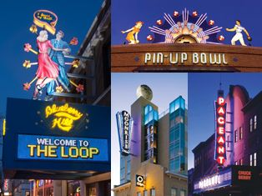
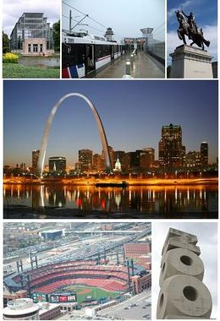
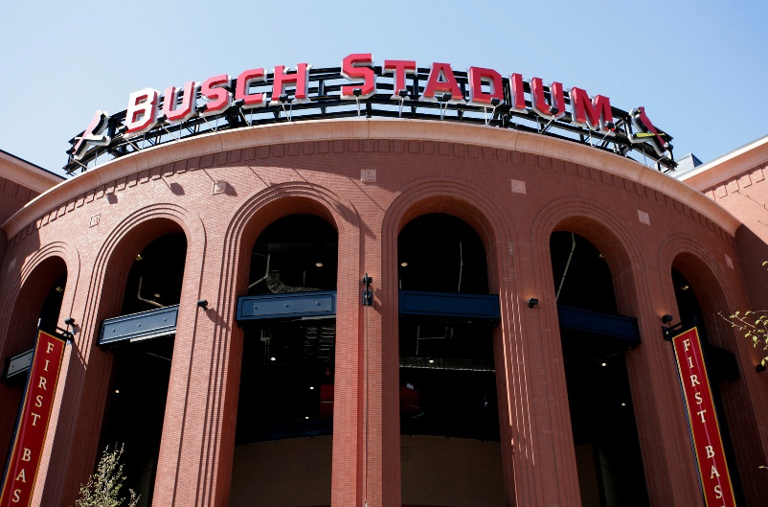
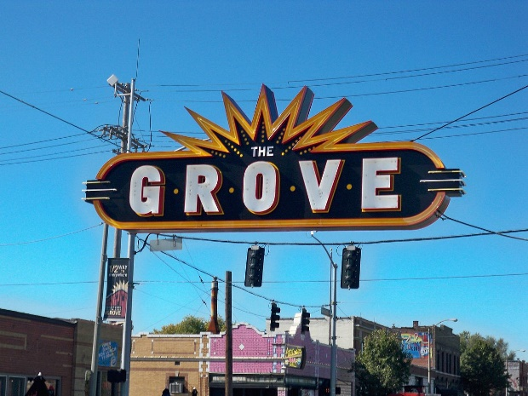
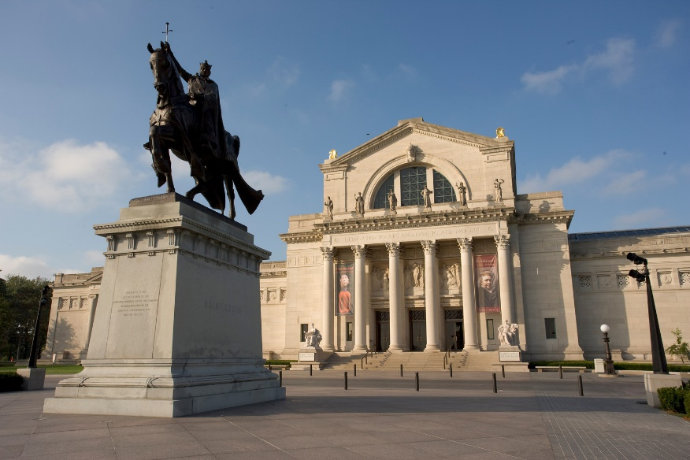
Living in St. Louis
Plenty of fun attractions, minutes from campus
Many are low cost or even FREE!
We love to celebrate food (festivals, Food Truck Fridays, etc.)
Notes:
St. Louis has something to offer every interest! We are a smaller city, but there is never a lack of things going on. There are several fun areas that include restaurants, bars, clubs, etc. We have some large universities in town (Washington University, St. Louis University), so although we would not be considered a “college town” there is quite a large population of young adults in the area.
During the spring and summer months there is always some type of outdoor festival going on. Many are focused on FOOD! You may not develop a taste our St. Louis style pizza (we get it – provel cheese is not everyone’s thing) but you probably will love the toasted ravioli and gooey butter cake. We also have many areas that offer specific types of cuisine. One example is the Hill, which has some of the best Italian restaurants around!

Slide 16
Fontbonne University ISPP Program Overview
Summer | Fall | Spring
First Summer: Interns begin on-campus courses the first week of July Program Orientation Graduate courses (6 cr) | First Fall: Graduate courses (10 cr) Includes pre-supervised practice experiences* | Spring: Graduate courses (12 cr) Includes pre-supervised practice experiences*
Second Summer: Supervised Practice begins 1 online graduate course (3 cr) | Second Fall: Supervised Practice, continued Program completion & graduation in December
*At least 80 supervised practice hours are built into the first Summer, Fall and Spring semesters via program organized activities. Interns may exceed this by completing additional volunteer activities (maximum 40 hours) that are overseen by the director and can be used toward time off (sick, personal, and vacation days) during supervised practice.
Notes:
Overview of the program.

Slide 17
Year One: Graduate Coursework & Pre-Supervised Practice
Semesters 1 – 3 include full time graduate course work
Pre-supervised practice experiences built into fall & spring semesters
Catering event
Pediatric counseling/education experience
Campus community wellness intervention
MNT review course to boost clinical skills
Field trips/other active learning experiences
Many required projects & experiences count toward supervised practice hours

Slide 18
MA in FCS Required Concentration Courses
Framing Critical Issues in FCS
Advocacy and Public Policy: Addressing a World in Need
Leadership Development for Professional Practice
Applied Health Behavior to Enhance Health Outcomes
Interpreting and Translating Science for Consumers
Contemporary Applications for Health Communication
Statistical Methods for Research
Elective: Ethical Implications for Health Communication OR Cultural Competence in Health Communication
Detailed course descriptions can be found on our website
Notes:
The MA in FCS is a unique program that offers courses related to communicating health information to patients/clients and influencing health outcomes. Course descriptions can be found on our website.

Slide 19
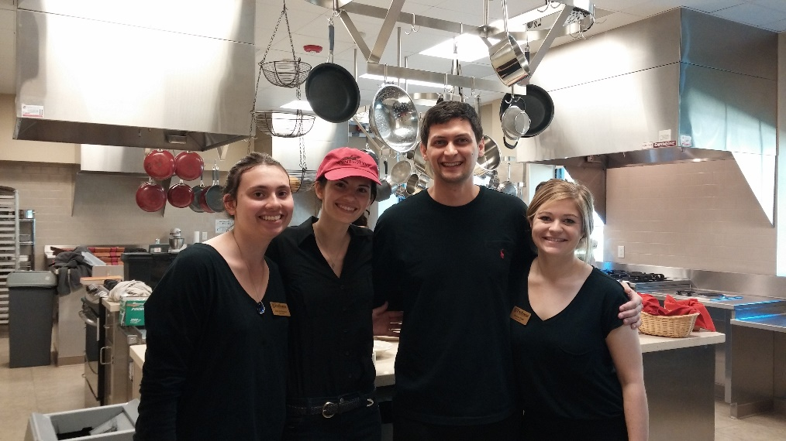
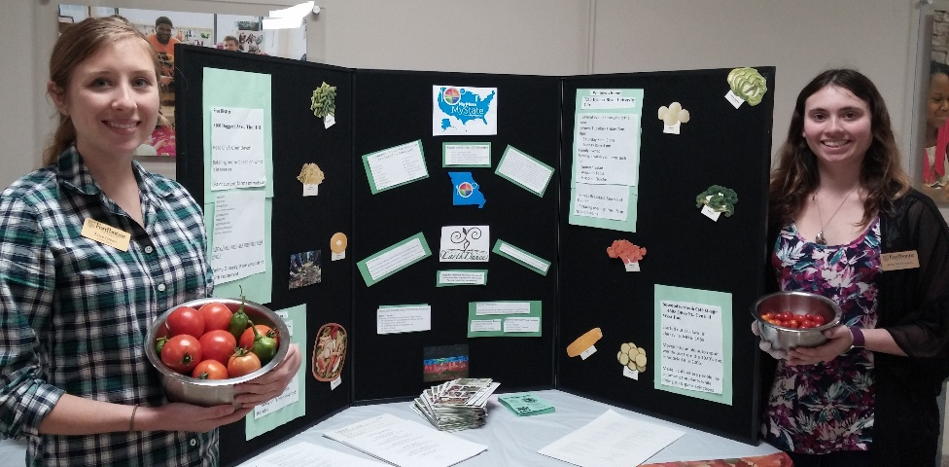
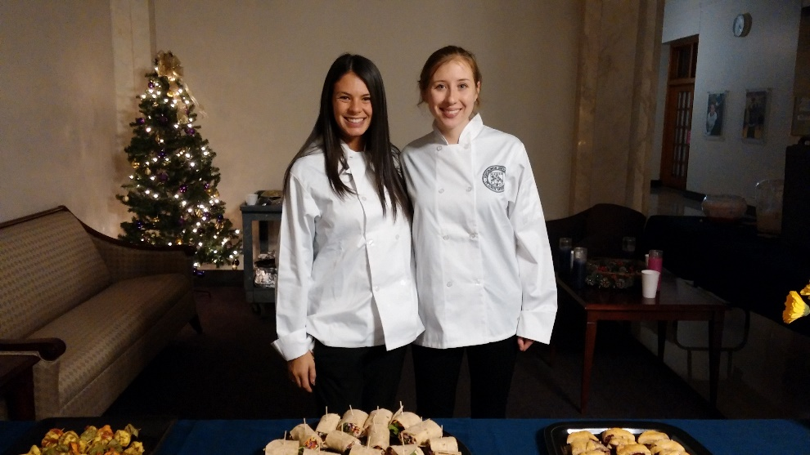
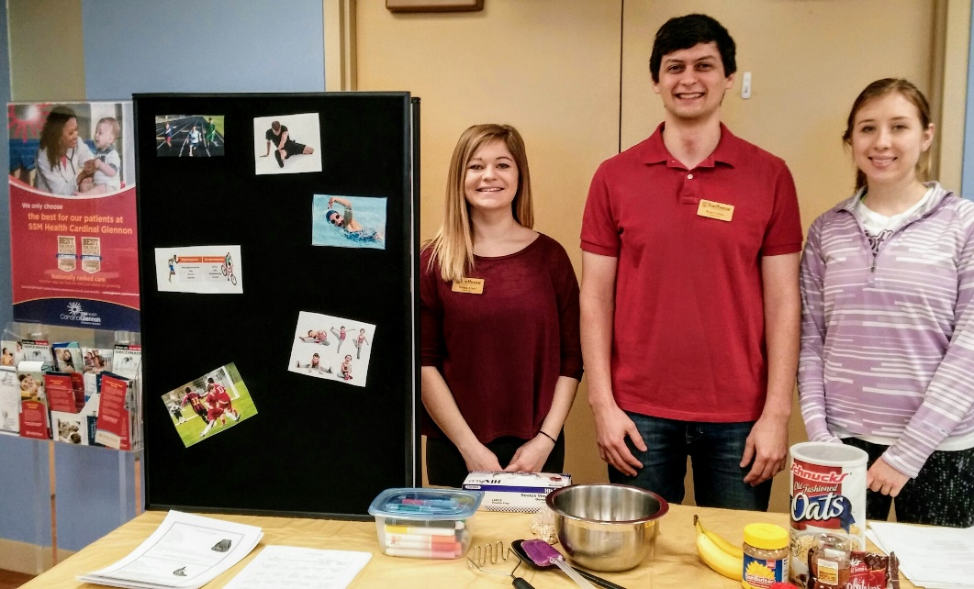
Year One: Pre-Supervised Practice
Campus Wellness Table
Catering Campus Events
Education Session at a Pediatric Medical Office
Notes:
Examples of activities during graduate school. Each of these projects helps you to build your skills for supervised practice, and counts toward hours.

Slide 20
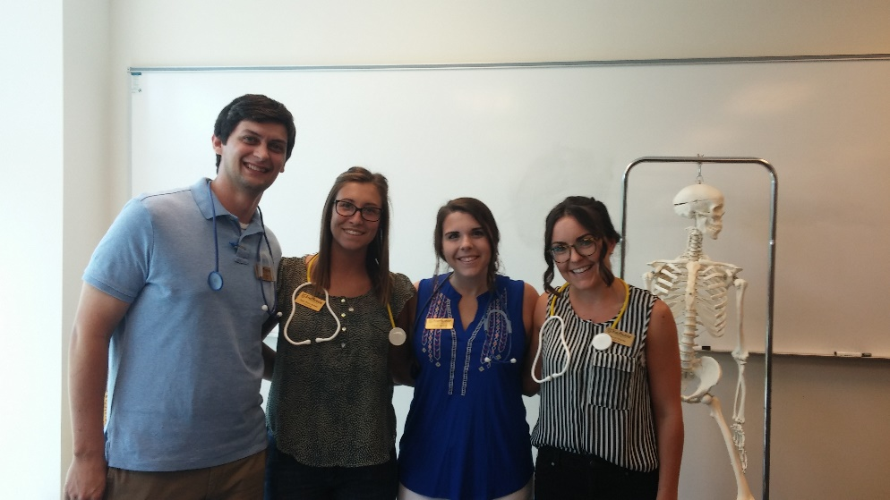
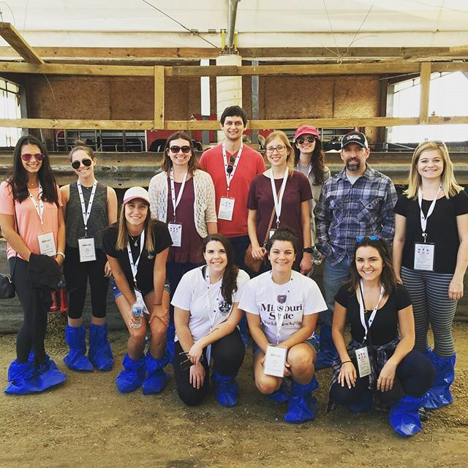
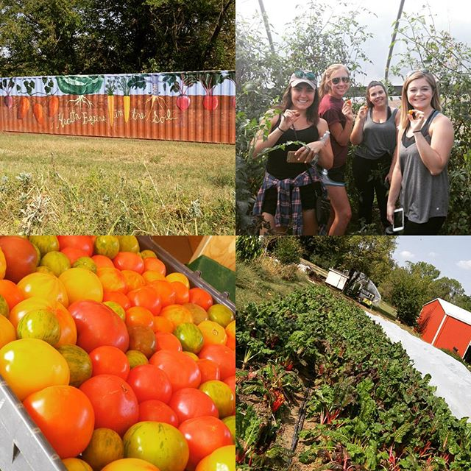
Year One: Pre-Supervised Practice
Nutrition Focused Physical Exam Workshop
Visit to a local organic farm
Dairy Farm Tour
Notes:
Field trips and experiences to enhance learning! Many of these meet competencies and therefore count toward practice hours.

Slide 21
Year Two: Supervised Practice
Completed during final two semesters
Total of 30 weeks
10 – 12 weeks clinical
8 - 10 weeks food service management
8 - 10 weeks community
2 – 4 weeks electives/special interest rotations
Interns provide input on rotation selections to individualize the experience
Notes:
Supervised practice occurs between May and December of the second year.
Exact # of weeks will vary from student to student
Each intern follows a unique path through supervised practice sites, and is asked for input on where they would prefer to go. Although we cannot guarantee all requests will be met, we do as much as possible to place students at sites of interest and where they are likely to be most successful.

Slide 22
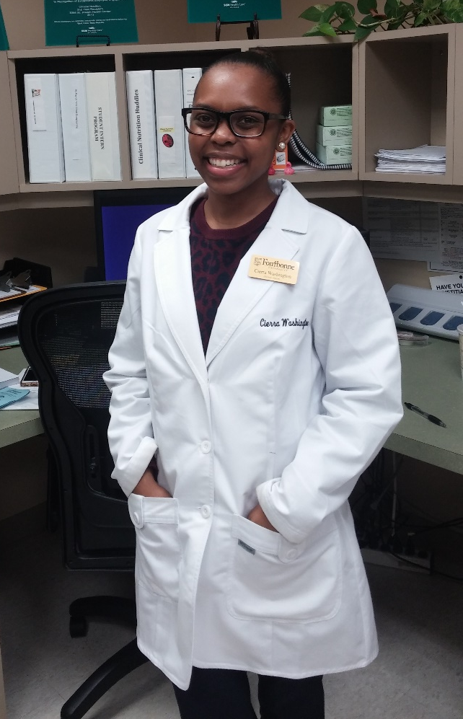
Clinical Rotation
Acute Care
small, mid size and large
facilities
Long term care / Rehab
Elective Sites
Cardiac Rehab
Dialysis
Outpatient Counseling
Outpatient Bariatric Surgery
Pediatrics
Notes:
Clinical rotations may include 2 – 3 different sites.

Slide 23
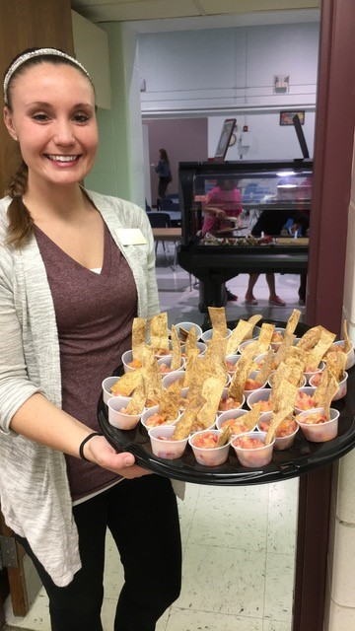
Food Service Management Rotation
Hospital Nutrition Services
Acute and Long Term Care
School Nutrition
K-12 & college/university
Elective sites
Grocery store/School of Cooking
Notes:
Students typically experience 1 or 2 food service management sites.

Slide 24
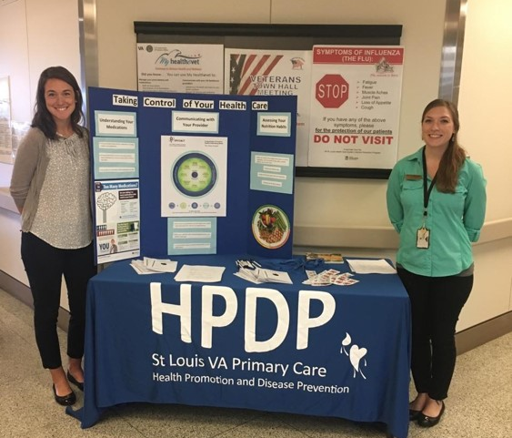
Community Nutrition Rotation
Local Outreach Programs
Agency on Aging
WIC
Cooking Matters
School Outreach & Youth Development
Public Health Department
Health Promotion & Disease Prevention Program
Private Practice
Sports nutrition, media, worksite wellness, holistic health
Agriculture and community gardening/farming education
Notes:
Students typically experience 3 – 5 community sites.

Slide 25
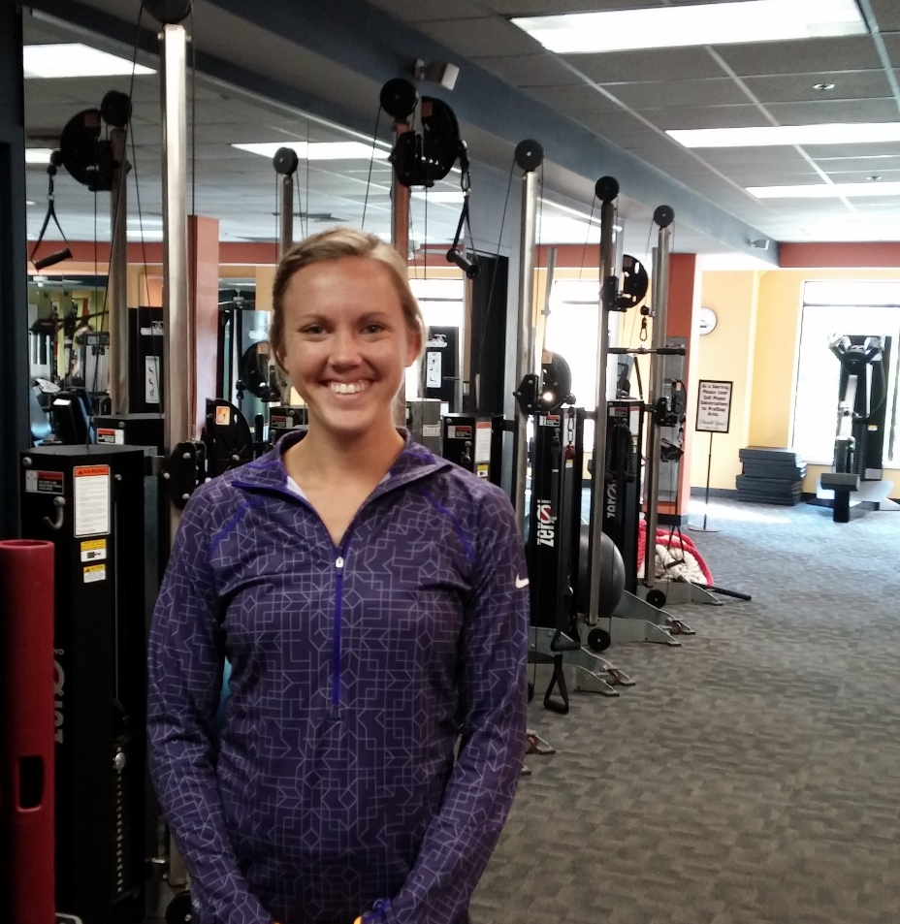
Electives/Special Interest
Extended rotations in any area
Sports/Fitness
Holistic Health
Private Practice/Business
Department of Corrections
Sites can be added based on student contacts!
Notes:
We have agreements with many local sites; however, there are times when we don’t have a current site to fit a particular student interest. We welcome students to suggest sites and/or start conversations with local practitioners they would like to work with. If there is mutual interest, we will work with these sites to establish the appropriate agreement to send the student there for a rotation.
Examples of student suggested sites that we have established agreements with include a holistic health private practice, sports nutrition, and the state Department of Corrections.
Short rotations out of town can also be established. On a few occasions, students have returned to their home town to complete a short rotation with a local practitioner. We are open to working with you on any idea that supports your learning and career goals.
It is not a requirement that students set up their own elective/special interest rotations; simply an option if desired.

Slide 26
Fontbonne University ISPP Estimated Program Costs
Tuition & Fees (based on 2017-18 rates) | $30,880
Additional Course Fees (covers cost of RDN Exam Study Guide and computerized competency tracking tool) | $500
Textbooks and Reference Materials* | $ 800
Professional Liability Insurance | $ 15/year
Health insurance & **Auto Insurance | Varies by plan
Background checks/drug screen | $200
ServSafe® certification (if not currently certified) | $80
***Housing/meals/transportation | $1000 (depends upon location and if accommodations are shared)
AND & local chapter membership | $74/year
Professional development/conference attendance (optional) | $400 – $1200
*Reliable computer and internet access are required
**A private vehicle is necessary, as supervised practice sites are located 5 to 45 miles from campus and public transportation is not feasible. Proof of auto liability insurance is required. Sites may assess parking fees.
***Apartment style housing is available for graduate students living on campus
Notes:
A reliable automobile is required. Public transit in the city is not adequate for traveling to sites.
Many interns share housing to save on costs. Connections to other selected interns will be made once all are accepted and confirmed.

Slide 27
Admission Criteria
General Qualifications
3.2 DPD GPA (combined professional & science)
3.0 overall GPA
MNT coursework within the last 5 years
GRE scores are not required
Other desirable attributes:
Potential for success in graduate school
Strong personal statement and letters of recommendation
Profession-related experience (work or volunteer)
Engagement in leadership and service
Fit with our program and focus
Unique perspective

Slide 28
When and How to Apply
If you have ever received a “no match,” you may apply via DICAS beginning Thursday, April 11th 2019 at 11am
You must also apply to our graduate program
Please see our website for specific application instructions
Applicants who meet minimum qualifications will be contacted to set up a phone or video interview
Preference will be given to applications received by Sunday, April 14th
We will continue to review applications on a rolling basis until our class is full
If accepted…
Selected applicants must confirm within 24 hours of notification
You must make arrangements to relocate to St. Louis, MO for orientation and the start of summer courses by July 1^{sr}, 2019

Slide 29
FAQ’s
Housing
On campus apartment style housing available
learn more on our website
Tuition assistance
Federal loans available due to part time status throughout program
Graduate work study positions available
One position per semester in our department
Other positions may be available on campus
Visit the Financial Aid webpage for more information
Limited scholarships available via Academy and state dietetics association
Working during the program
Not recommended during supervised practice
During graduate school, ~20 hours per week is the norm and manageable according to former students
Schedule must be flexible to accommodate required activities
When are courses held?
Graduate courses begin 4:30pm or later, although some ISPP required classes begin as early as 3pm

Slide 30
For more information…
Visit our website: www.Fontbonne.edu/ISPP
Contact me:
Email: DFrench@Fontbonne.edu
Phone: 314-889-4760
Keep up with us on social media:
@fontbonneispp
@Fontbonne University ISPP
Social media pages are maintained by current ISPP students!
Feel free to connect with them and ask questions “from a student’s view”, or send an email directly to ISPPstudent@Fontbonne.edu

Slide 31
Good Luck on your Applications!
Thank you for considering our program

